Slide 1
Algorithms and Flowcharts

Slide 2
Algorithm
An algorithm is an effective method expressed as a finite list of well defined instructions for calculating a function, starting from an initial state and initial input. The instructions describe a computation, which will eventually produce output, when executed.
We can use algorithm to solve any kind of problems. However, before writing a program, we need to write the steps to solve the problem in simple English language. This step-by-step procedure to solve the problem is called algorithm.

Slide 3
Let us take one simple day-to-day example by writing algorithm for making “Maggi Noodles”
Step 1: Start
Step 2: Take pan with water
Step 3: Put pan on the burner
Step 4: Switch on the gas/burner
Step 5: Put magi and masala
Step 6: Give two minutes to boil
Step 7: Take off the pan
Step 8: Take out the magi with the help of fork/spoon
Step 9: Put the maggi on the plate and serve it
Step 10: Stop.

Slide 4
The way of execution of the program shall be categorized into three ways:
sequence statements
selection statements
iteration or looping statements. This is also called as “control structure”.

Slide 5
Sequence statements: In this, all the instructions are executed one after another.
Example: Write an algorithm to find area of a rectangle
Step 1: Start
Step 2: Take length and breadth and store them as L and B?
Step 3: Multiply by L and B and store it in area
Step 4: Print area
Step 5: Stop

Slide 6
Selective Statements: In this program, some portion of the program is executed based upon the conditional test. If the conditional test is true, compiler will execute some part of the program, otherwise it will execute the other part of the program.
Example 1: Write an algorithm to check whether he is eligible to vote? (more than or equal to 18 years old)
Step 1: Start
Step 2: Take age and store it in age
Step 3: Check age value, if age >= 18 then go to step 4 else step 5
Step 4: Print “Eligible to vote” and go to step 6
Step 5: Print “Not eligible to vote”
Step 6: Stop

Slide 7
Example 2 : Write an algorithm to check whether given number is +ve, -ve or zero.
Step 1: Start
Step 2: Take any number and store it in n.
Step 3: Check n value, if n > 0 then go to step 5 else go to step 4
Step 4: Check n value, if n < 0 then go to step 6 else go to step 7
Step 5: Print “Given number is +ve” and go to step 8
Step 6: Print “Given number is -ve” and go to step 8
Step 7: Print “Given number is zero”
Step 8: Stop

Slide 8
In the above mentioned examples 1 & 2, all the statements are not executed, but based upon the input, some portions of the algorithm are executed, because we have “true” or “false” situation in the program.

Slide 9
Iterative statements: In some programs, certain set of statements are executed again and again based upon conditional test. i.e. executed more than one time. This type of execution is called “looping or iteration”.

Slide 10
Example 1:Write an algorithm to print all natural numbers up to “n”
Step 1: Start
Step 2: Take any number and store it in n.
Step 3: Store 1 in i
Step 4: Check i value, if i<=n then go to step 5 else go to step 8
Step 5: Print i
Step 6: Increment i value by 1
Step 7: Go to step 4
Step 8: Stop

Slide 11
In the above example, steps 4, 5, 6 and 7 are executed more than one time.

Slide 12
Flowchart
A flowchart is a visual representation of the sequence of steps and decisions needed to perform a process. Each step in the sequence is noted within a diagram shape. Steps are linked by connecting lines and directional arrows. This allows anyone to view the flowchart and logically follow the process from beginning to end.
A flowchart is a powerful business tool. With proper design and construction, it communicates the steps in a process very effectively and efficiently.

Slide 13
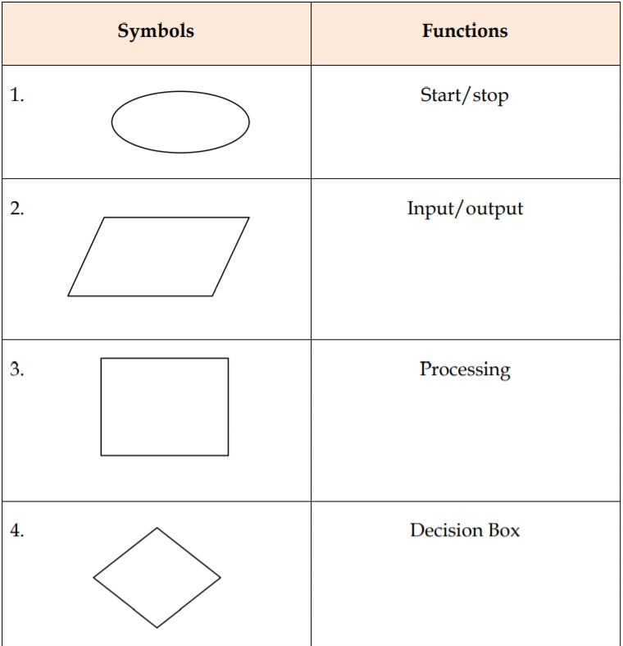
Flowchart Symbols
Some of the standard symbols along with respective function(s) that are used for making flowchart are as follows:

Slide 14
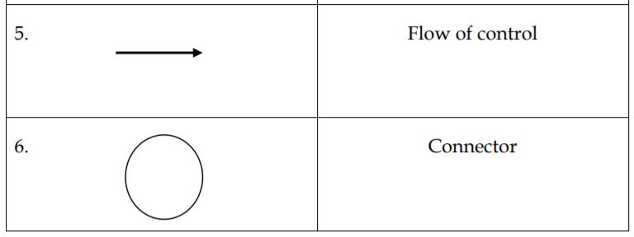

Slide 15
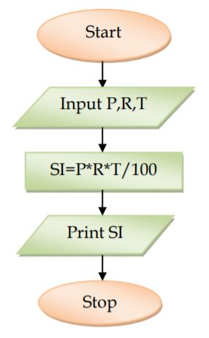
The following flowchart is an example of a sequential execution: Example: Draw a flowchart to find the simple interest. (Sequence)

Slide 16
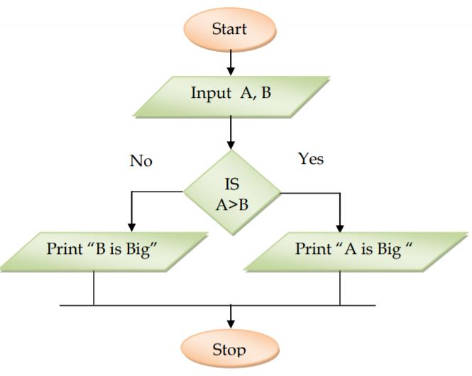
The following flowchart is an example of a selective execution:
Example: Draw a flowchart to find bigger number among two numbers (selective)

Slide 17
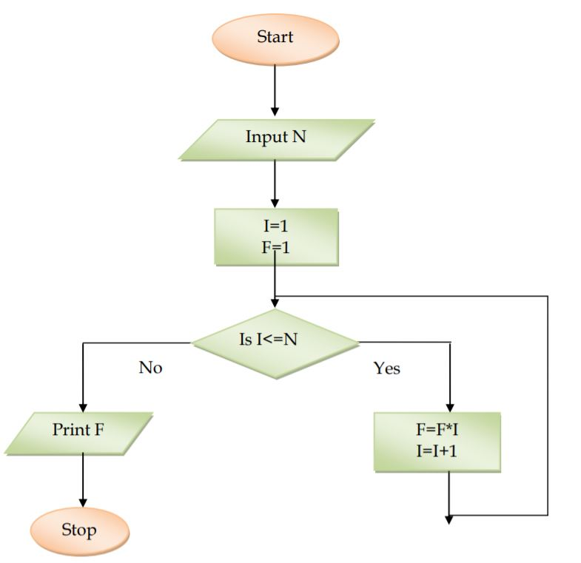
The following are the examples of an iterative execution:
Example: Draw a flow chart to find factorial of any number.

Slide 18
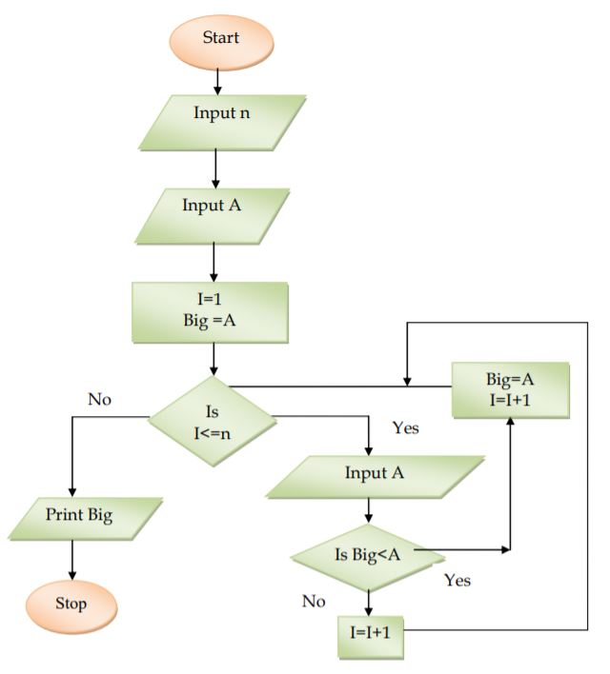
Example: Draw a flow chart to find biggest number among “n” numbers:

Slide 19
Finite and Infinite loop
In looping statements, if some set of statements are executed “n” times (fixed number of times), then it is called “finite loop”. At the same time, if some set of statements are executed again and again without any end (infinite times), then it is called “infinite loop”. For example (X), if we are not incrementing “I” (index) value, then we will get endless (infinite) loop. The following is an example of infinite loop:

Slide 20
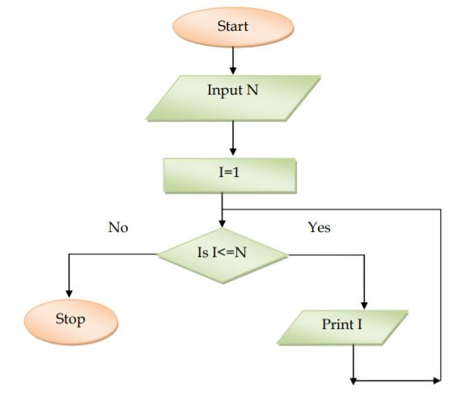

Slide 21
In the above example “I” value is not at all incremented, so it will create endless loop. This is also called infinite loop.

